Slide 1
Chat Platform

Slide 2
Objective
Objective: Develop a live messaging platform that replicates the functionality of popular chat applications, enabling users to engage in real-time conversations across various chat rooms.
Instant Communication: Utilize WebSockets to provide a smooth and uninterrupted messaging experience, eliminating the need for page refreshes while maintaining continuous chat interactions.
Scalability: Design the system to support an increasing number of users efficiently, ensuring seamless real-time message transmission as the platform expands.

Slide 3
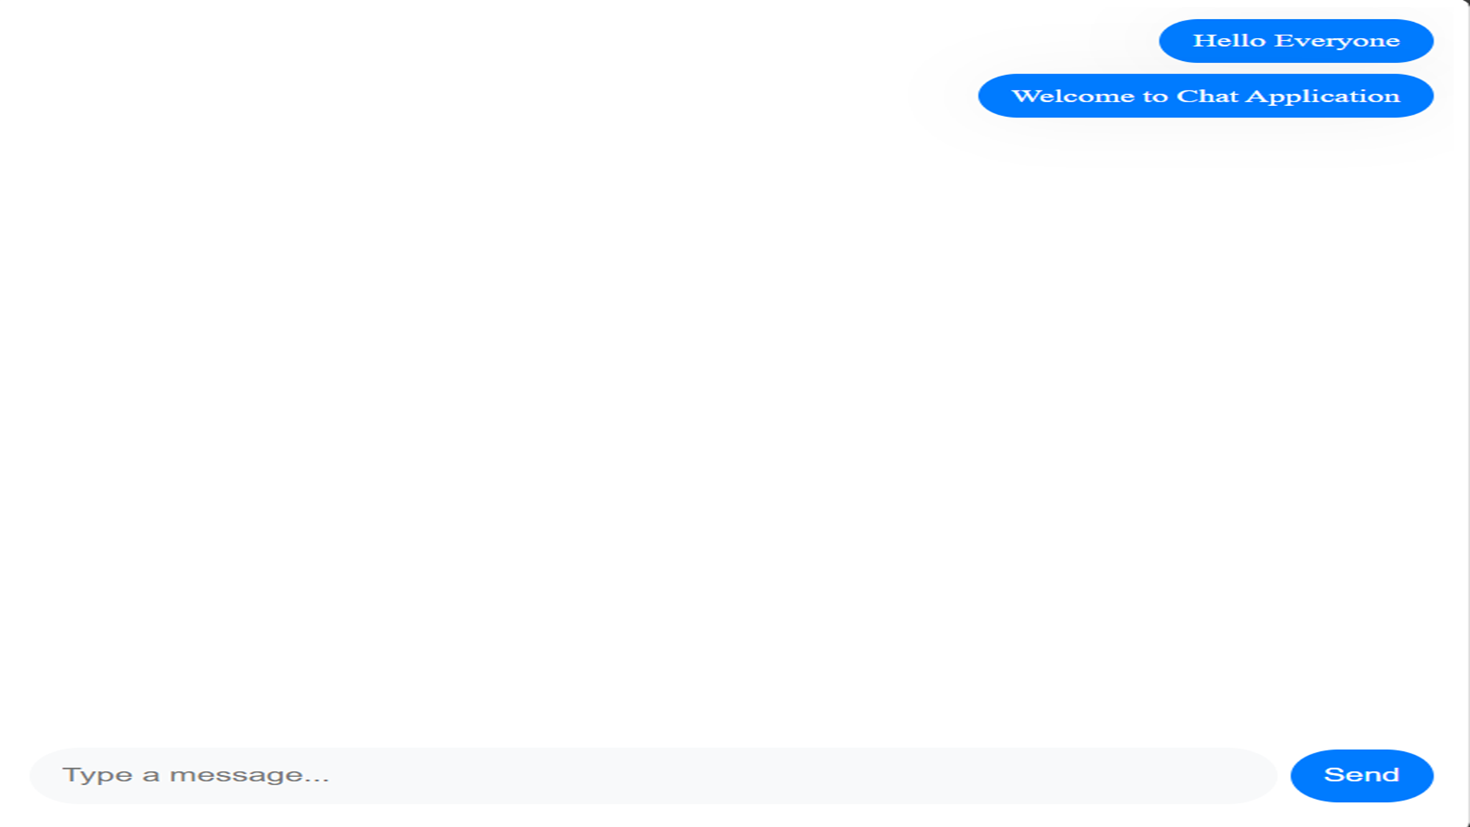
Chat Zone

Slide 4
Detailed Aspect
Conversational Panel: Each chat room will feature a dedicated message section, a text input field for composing messages, and a roster of active participants.
Chat Text Styling: Messages will support bold, italic, and hyperlink formatting to enhance expressiveness.
Dynamic Room Updates: The room list will refresh dynamically, displaying newly created rooms in real time.
Adaptive Design: The interface will adjust seamlessly to different screen sizes using CSS media queries and flexible grids, ensuring accessibility across all devices.
Notes:
(These don’t have designer IDs since they were based off the default master slides already in the deck.

Slide 5
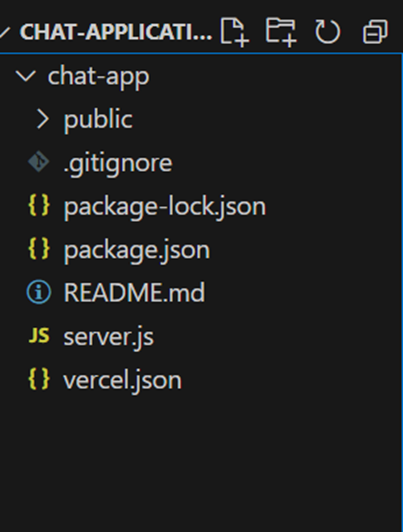
Project Directory layout

Slide 6
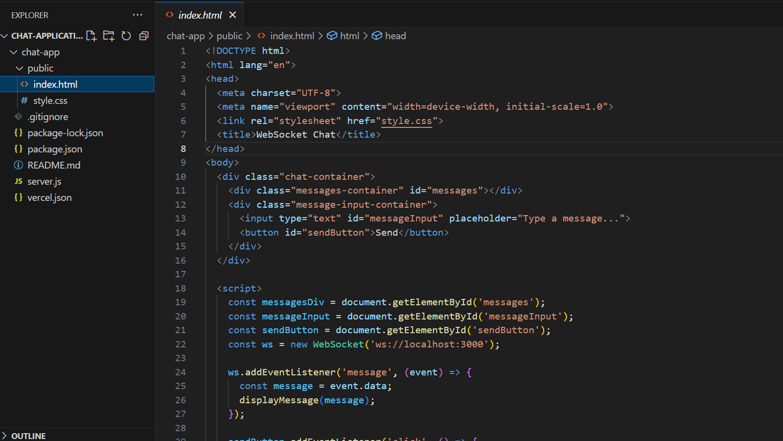

Slide 7
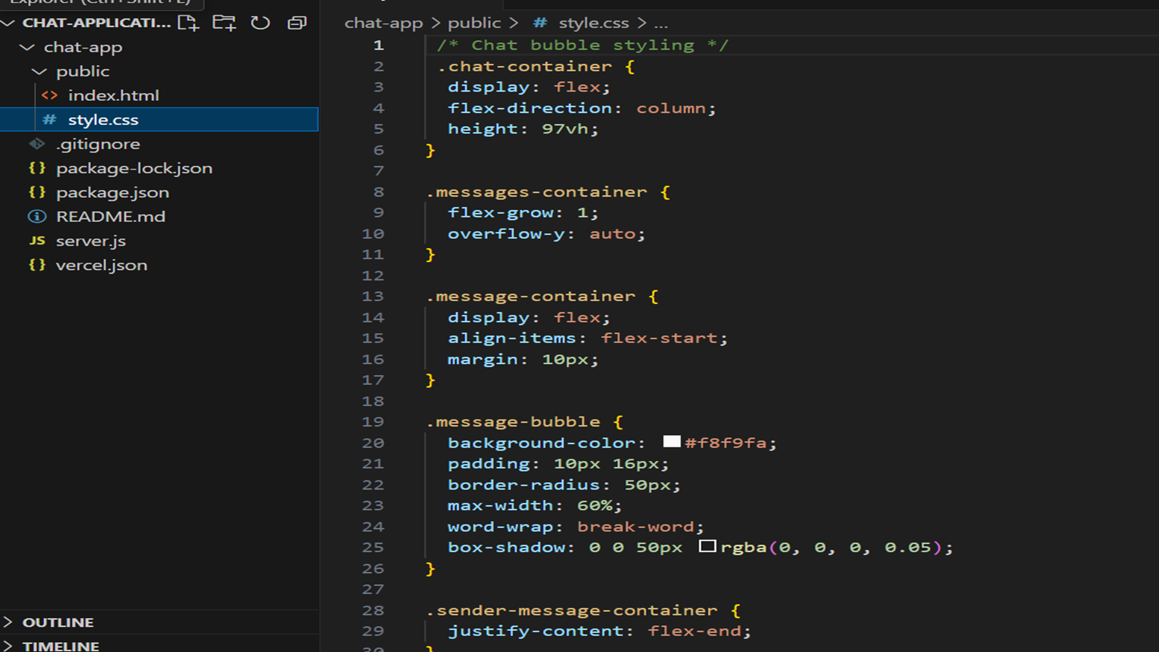

Slide 8
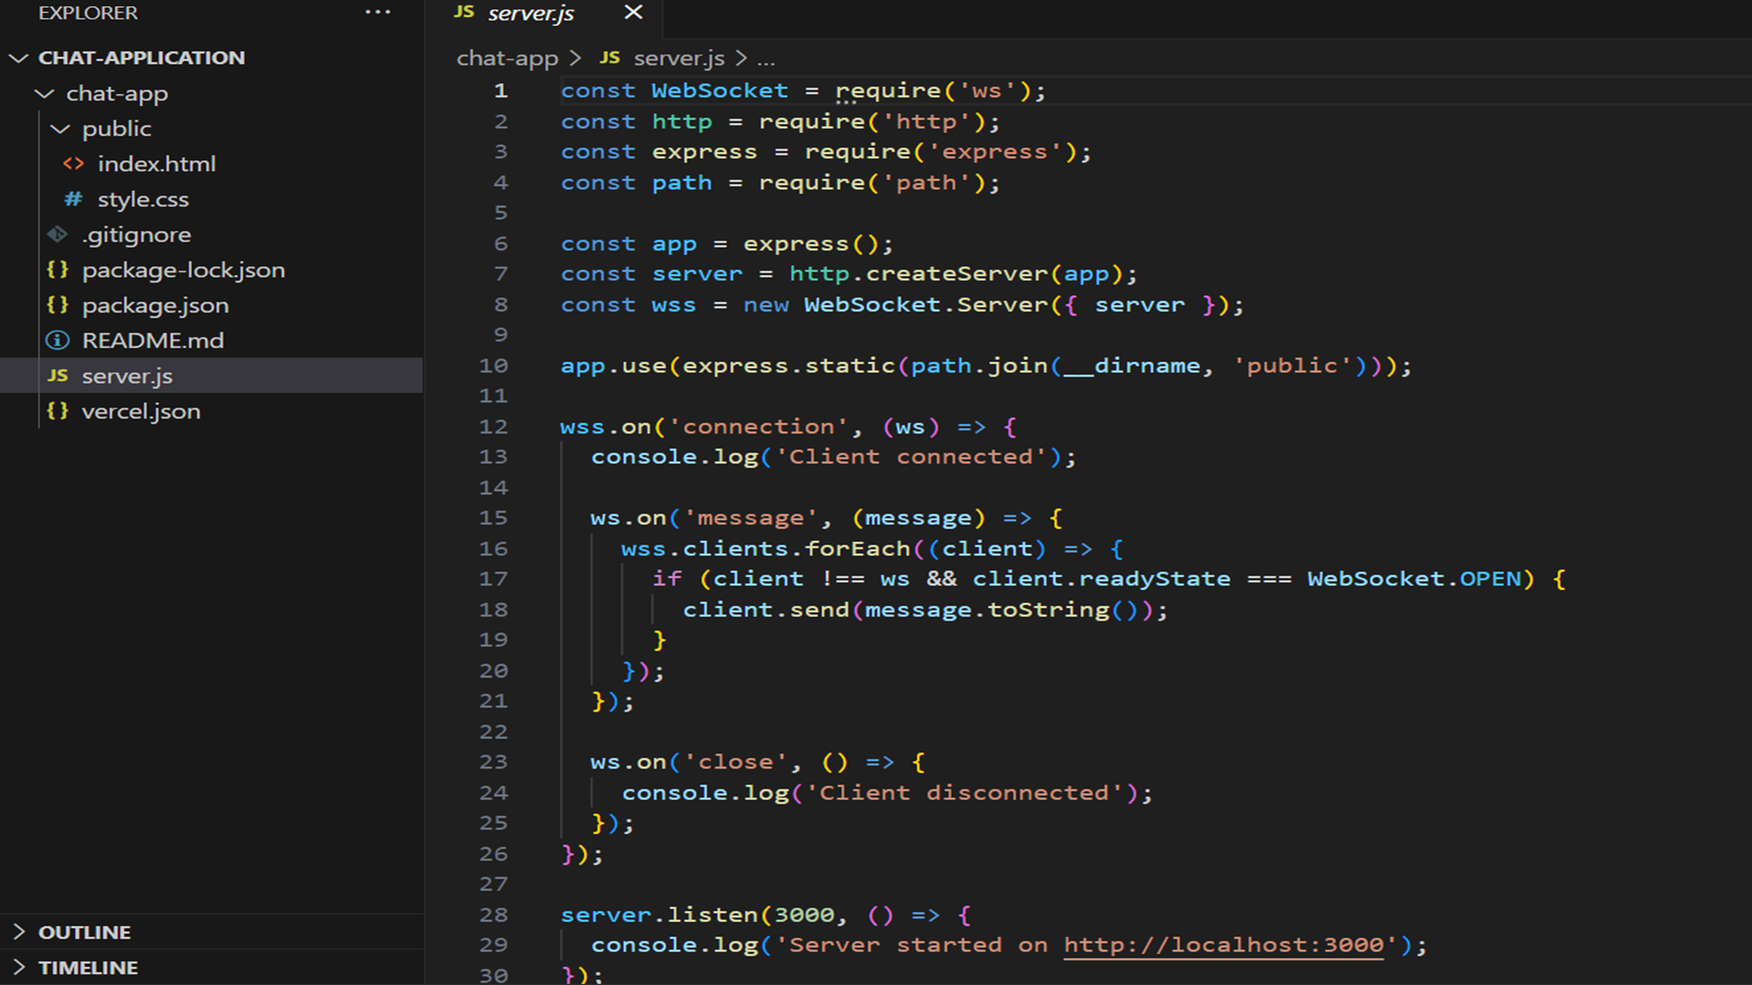

Slide 9


Safety Measures and Exceptions
Data Validation: Utilize regular expressions (regex) to check usernames, ensuring they don't include restricted characters and adhere to the specified character length limits.
Authentication Security: Implement a basic session management system, such as cookies or localStorage, to maintain user login status across multiple sessions.
Handling Disconnections: In the event of a user disconnecting, make sure to notify other participants in the room and consider restoring their previous state when they rejoin.

Slide 10
Obstacles and approaches
Challenge: Real-Time Messaging Maintaining continuous communication between multiple users can be challenging, especially when managing disconnections. Solution: Implement WebSockets to enable real-time updates without needing to refresh the page. Store message data on the server to ensure continuity when a user disconnects and reconnects.
Challenge: UI Consistency Ensuring the interface remains consistent and functional across different devices. Solution: Use media queries and responsive layouts, and conduct thorough testing on various devices (mobile, tablet, desktop) to ensure a seamless experience.

Slide 11
Building a real-time chat application offers several benefits, from enhancing user communication to providing valuable practical experience with technologies like WebSockets and managing real-time data streams. Additionally, focusing on a smooth and intuitive UI/UX is crucial for keeping users engaged and ensuring a seamless experience, which is key to the app’s success.
Conclusion

